Slide 1


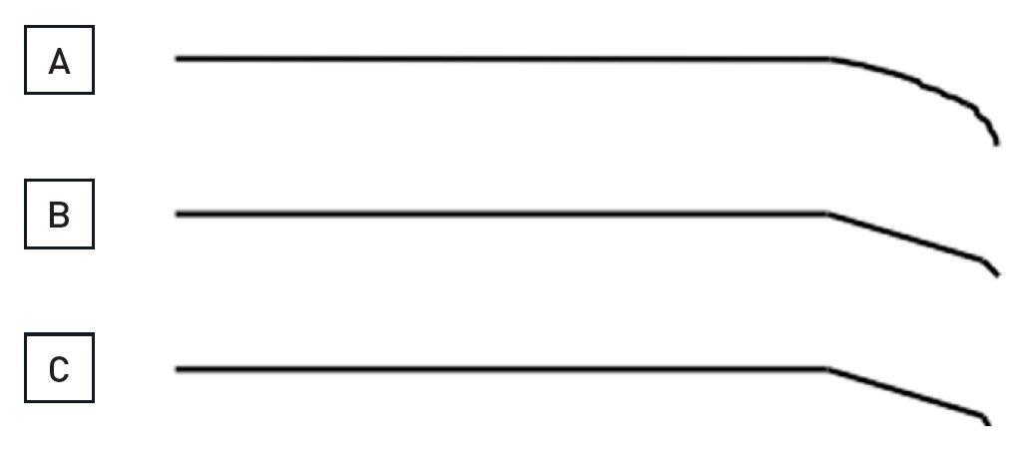

Chronic total occlusions
Figure 18
The shaping of the wire is crucial for a successful passage through an occlusionThe wire shape needs to be modified during the different stages of a procedure. A rounded (A) or more angled shape (B), the latter with a more pronounced distal tip angle of about 30° over the last 1mm to 2 mm of the wire, and a more proximal 30° secondary angle will serve many situations. For distal re-entry manoeuvres, or during a parallel wire approach, a more pronounced distal tip angle might be needed (C).
Gerald S. Werner
©2025 Europa Group - All rights reserved.

