Slide 1


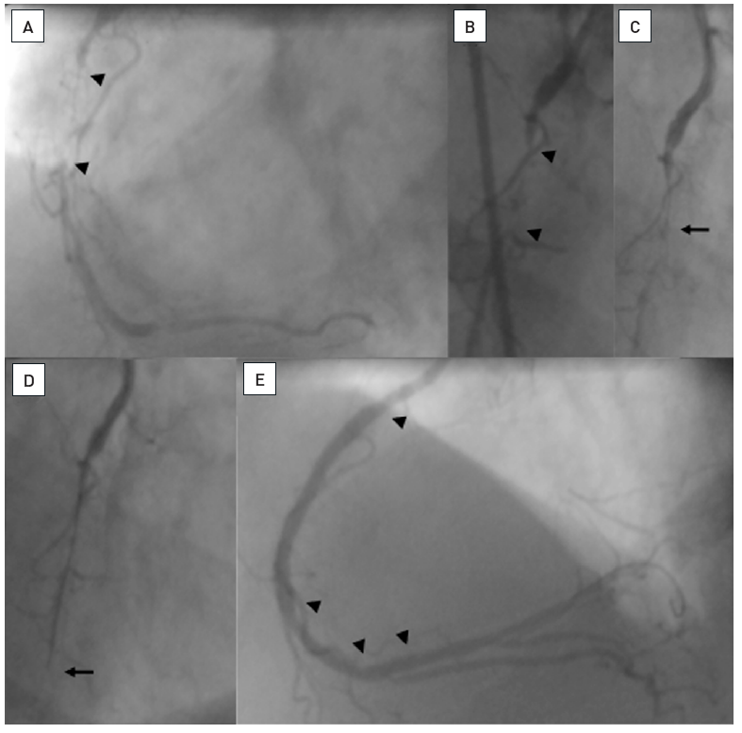

Chronic total occlusions
Figure 19
A patient with a 25 mm occlusion of the proximal RCA (A and B, between arrow heads). Initially a Fielder XT was tried and advanced into the occlusion as far as shown on C (arrow). Despite the support catheter, the wire could not advance further. Thus, a Miracle 3G was exchanged and could then be advanced beyond the distal occlusion cap (D, arrow), the position was verified by contrast filling. The angioplasty required stenting of the occlusion (E, top arrow heads), but also treatment of the distal RCA bifurcation (arrow heads).
Gerald S. Werner
©2025 Europa Group - All rights reserved.

