Slide 1


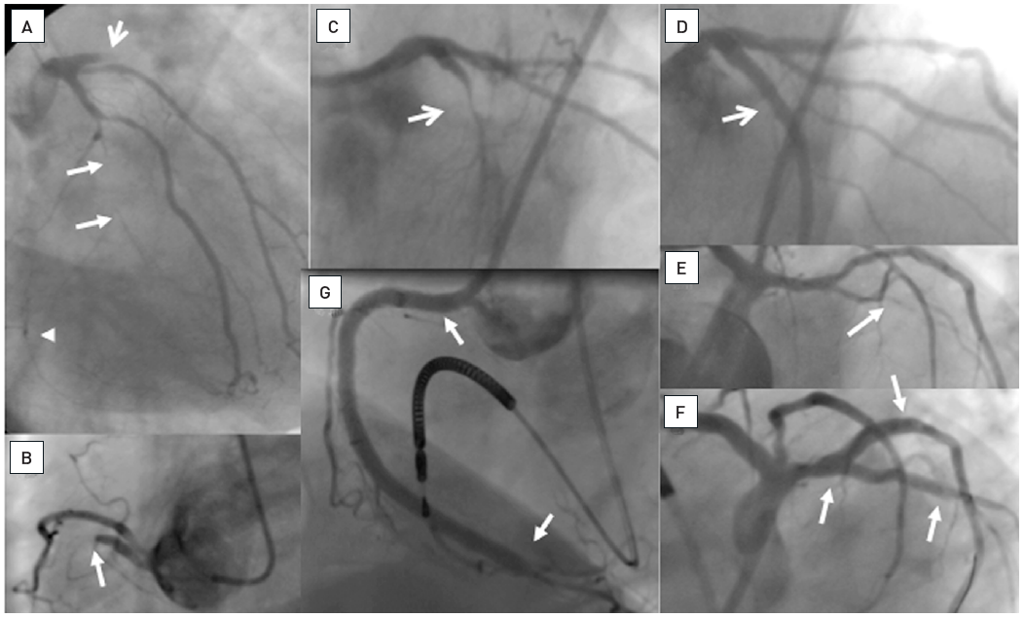

Chronic total occlusions
Figure 2
A 54 year old male without previous history of coronary artery disease admitted for acute chest pain with anterior ST elevation. He has an acute proximal LAD occlusion (open arrow; A) as well as chronic occlusions of the mid LCX with ipsilateral collaterals (between arrows), and a proximal RCA (arrow, B), supplied via collaterals from the LCX (arrow head, A). Primary PCI of the LAD is performed with thrombus aspiration (open arrow, C) with DES (between open arrows, D). Before the next stage an ICD was implanted, and then the LCX was recanalised (arrow, E) with bifurcation stenting (between arrows, F). In a third stage, the RCA is recanalised with four DES (G).
Gerald S. Werner
©2025 Europa Group - All rights reserved.

