Slide 1


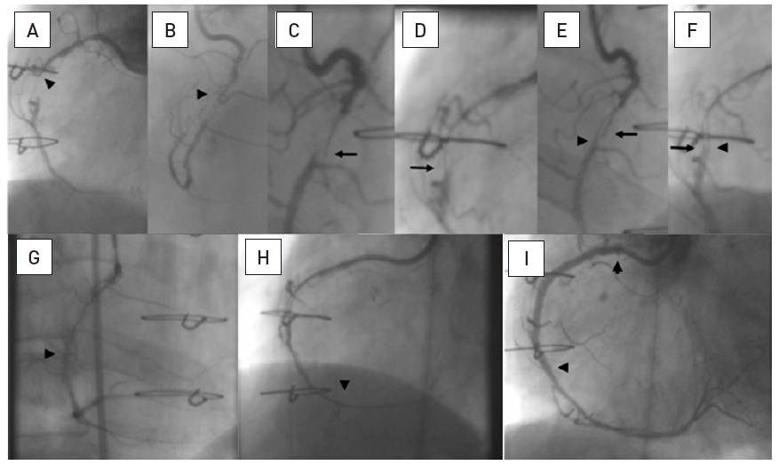

Chronic total occlusions
Figure 20
A patient post CABG with a 15mm occlusion of the mid RCA with the proximal occlusion entry not identifiable at a side branch (arrow head A and B). Panels in clockwise orientation show the penetration of the cap and parallel wire approach. A Confanza Pro 9 wire is advanced to penetrate the proximal cap, but the tip (arrow) deviates to the anterior (C: RAO 30°) and lateral (D: LAO 30°). A second Confianza Pro 9 is advanced in parallel but with another course to correct for the malposition of the first wire, posterior in RAO (E) and more medial in LAO (F). Thus the second wire enters the distal cap, which is confirmed by contrast during wire advancement (G and H). The case is concluded with three DES shown between arrowheads.
Gerald S. Werner
©2025 Europa Group - All rights reserved.

