Slide 1


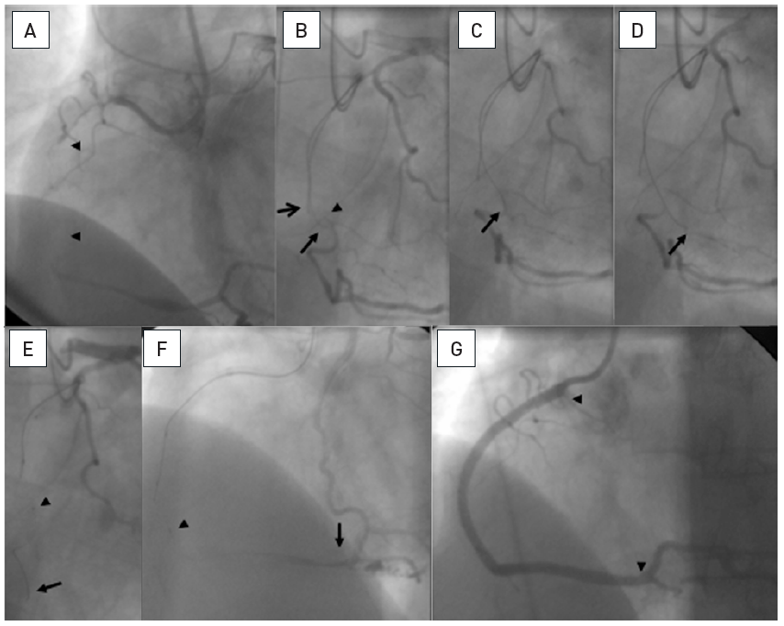

Chronic total occlusions
Figure 21
Long occlusion of the RCA with a diffusely diseased narrow segment proximal to the occlusion and a tortuous distal target segment (arrowheads A, B). Sequence shown in clockwise direction. A parallel wire approach is chosen, after the initial Miracle 3G wire got stuck (top arrow, B), and a second Confianza Pro 9 could be advanced further, but is now below the distal target (bottom arrow, B). Repositioning of the Confianza wire allowed entry into the distal lumen (arrow, C). With this stiff wire, however, the sharp angled distal tortuosity cannot be negotiated. A step down approach is required. The wire is placed in a distal side branch (arrow, D), to enable a low-profile balloon 1.25mm to be advanced after microcatheter exchange. After balloon dilatation, a microcatheter (QuciCross, Spectranetics, showing three markers, the distal is indicated by the arrow head) is reinserted and advanced distal to the occlusion (arrow head, E), and a soft PTFE wire (Whisper LS, Abbott Vascular) is then advanced distally (arrow, E and F). After balloon dilatation four DES are required to cover the diffusely diseased artery (arrow heads, G).
Gerald S. Werner
©2025 Europa Group - All rights reserved.

