Slide 1


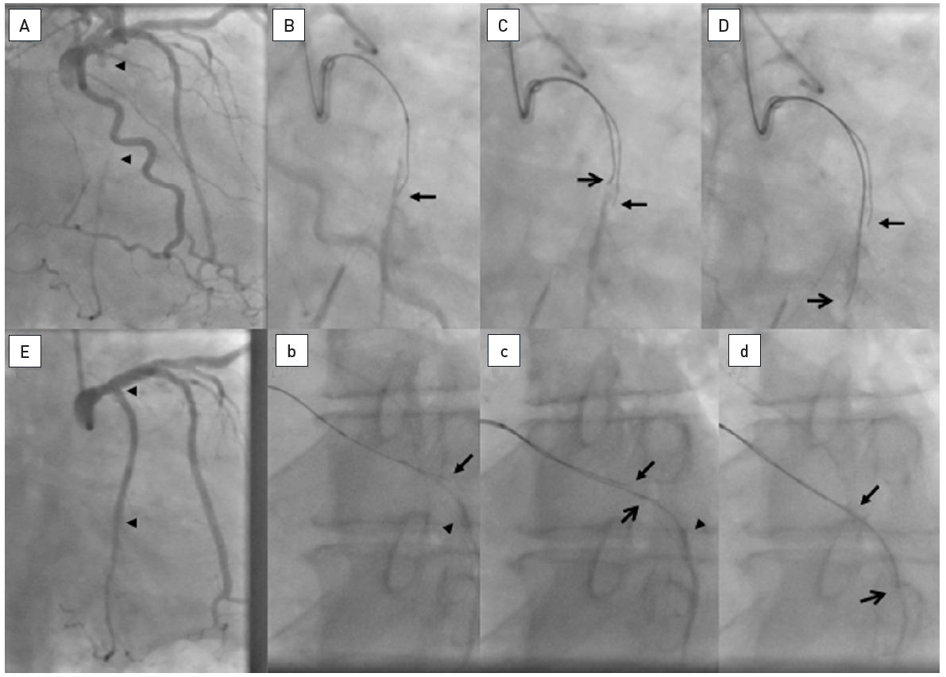

Chronic total occlusions
Figure 22
About 25mm long occlusion of the proximal LCX as visualized by a simultaneous bilateral injection (arrow heads, A). A 8F AL2 sidehole guide catheter is used. A biplane angiography was used to adjust the wire advancement. The first wire was a Confianza Pro 9 supported by a Finecross microcatheter. Contralateral visualization of the distal target (arrow head) shows, that the wire deviates clearly anterior on the RAO view (arrow, B), but on the LAO view it seems to be off course only in the distal part to the lateral (arrow, b). As second wire a Confianza Pro 12 is advanced over a separate microcatheter in see-saw technique correcting the wire course according to the previous wire more posterior in RAO (open arrow, C) and with a similar course in LAO with only a more caudal course distally (open arrow, c). With these adjustments, the distal lumen (arrow head) can be safely entered as visualized in both views simultaneously (open arrow, D and d). The final result is obtained with two DES (arrow heads, E).
Gerald S. Werner
©2025 Europa Group - All rights reserved.

