Slide 1


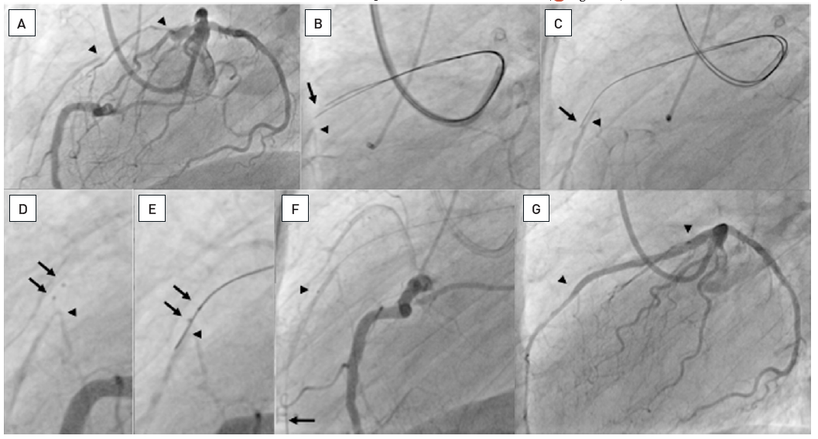

Chronic total occlusions
Figure 23
About 20mm long occlusion of the proximal LAD (between arrow heads, A). Sequence of panels in clockwise direction. A parallel wire approach using two Confianza Pro 9 wires did not lead to a distal entry, both wire tips (arrow) are above the distal target as visualized by contralateral injection (arrow head, B). One of the wires is advanced further (arrow) in parallel to the distal target (arrow head, C). Subsequently, after dilatation along the wire with a 1.25 and 2.0 mm balloon, the Stingray balloon catheter could be advanced. The two markers of the distal flat-shaped balloon are clearly visible (arrows) and positioned above the distal contrast filled target (arrow head, D). The the Stingray wire is advanced and directed to exit the catheter at that one of the two sideholes, which is directed downward towards the distal vessel. The wire exits the sidehole located between the markers (arrows) and reenters the distal lumen (arrow, E). After further advancement, the Stingray balloon catheter is exchanged using the trapping technique and a Finecross microcatheter advanced (arrow head), in order to then exchange the stiff Stingray wire for a soft floppy wire (arrow, F). Final result after two DES (arrow heads, G). Stenting was done under IVUS control ( see Figure 36 ).
Gerald S. Werner
©2025 Europa Group - All rights reserved.

