Slide 1


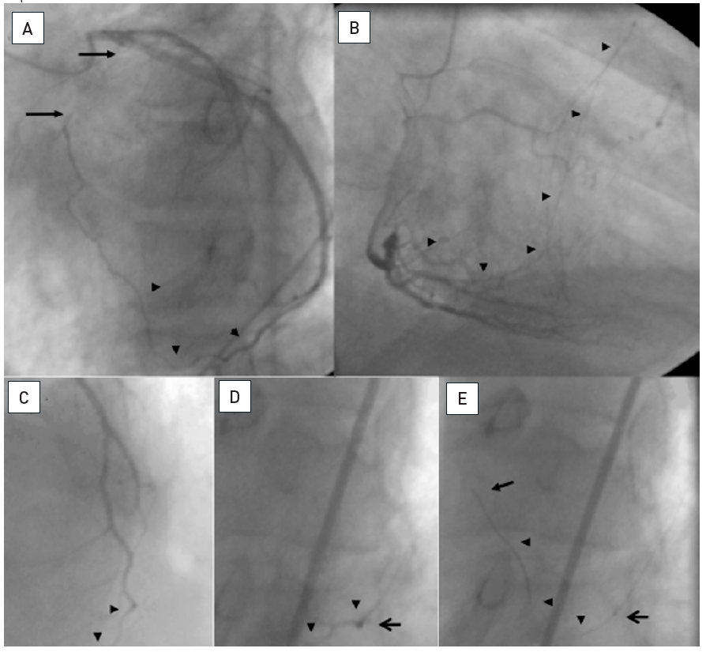

Chronic total occlusions
Figure 25
A: Proximal occlusion of the LAD (between arrows) collateralized via an epicardial connection from the distal LCX to a diagonal branch (arrowheads). B: Coexisting CC2 collaterals from the PDA to the LAD (arrow heads). The patient was brought back 4 months after the initial angiogram for PCI of the CTO. A retrograde approach was planned via the epicardial connection. At that time, however, the connection did no longer fill the diagonal (C, arrow heads) despite injection through a 8F guiding catheter. Advancement of a Finecross microcatheter (Terumo) (D, open arrow) and superselective injection through this catheter filled up the collateral only slightly better(arrow heads). E: Still, a Whisper LS wire (Abbott Vascular) could be gently advanced through the epicardial connection (arrow indicates wire tip, arrow heads wire course), and then later followed by the microcatheter (open arrow).
Gerald S. Werner
©2025 Europa Group - All rights reserved.

