Slide 1


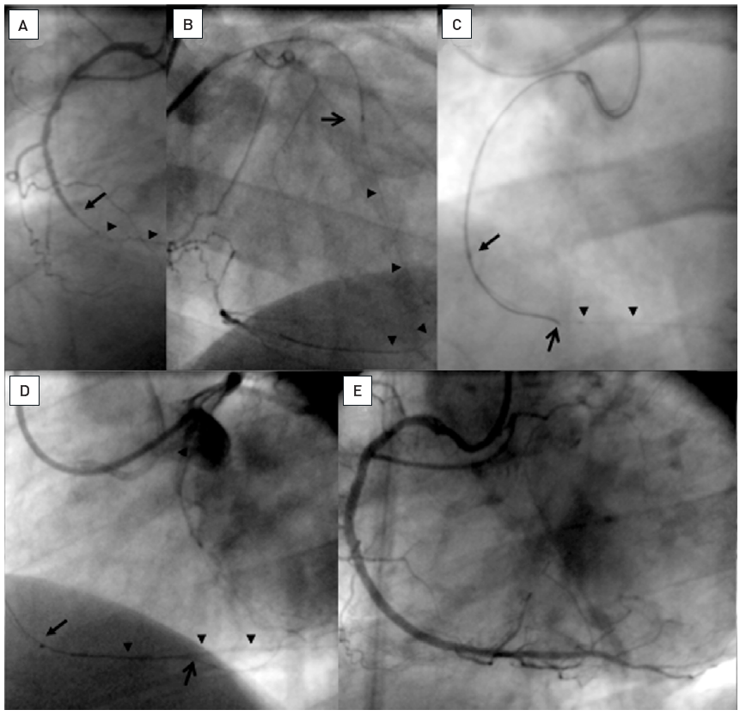

Chronic total occlusions
Figure 27
Occlusion of the RCA (A: arrow) with a long bridging collateral making the definition of the proximal entry point difficult. Therefore a retrograde approach was chosen via a first septal branch of the LAD. B: A Finecross microcatheter (Terumo) is advanced and a Whisper LS wire (Abbott Vascular) passed through the collateral connection into the PDA (arrow heads). The microcatheter could not be advanced further. C: The retrograde wire could be advanced into the occlusion towards the proximal entry. From antegrade a Miracle 3G wire (ASAHI Intecc) is advanced over a Finecross (arrow) along the retrograde wire as a marker further distally (open arrow). D: Finally the antegrade wire passed the occlusion into the distal segment, and the antegrade microcatheter is further advanced (arrow). E: Final result after 2 DES.
Gerald S. Werner
©2025 Europa Group - All rights reserved.

