Slide 1


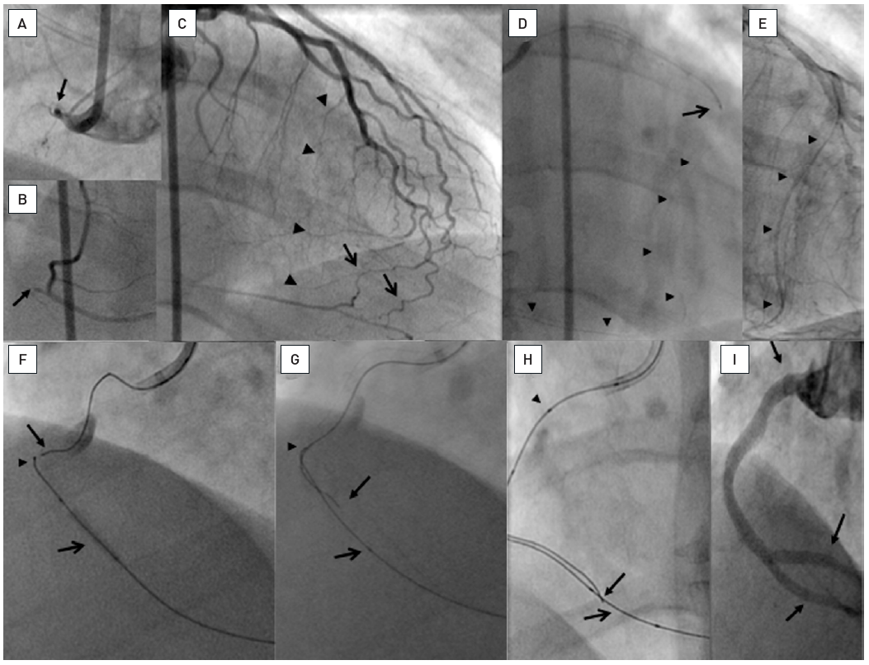

Chronic total occlusions
Figure 29
In clockwise sequence A: Proximal occlusion of the RCA (arrow) extending until the crux cordis (B, arrow). C: The LAD supplies epicardial (arrow) and septal collateral pathways to the PDA (arrow heads). D: The septal passage is chosen, and a 300 cm Whisper LS wire (Abbott Vascular) (arrow heads) passed through into the PDA. The wire is supported by a Transit microcatheter (Cordis) which cannot pass the collaterals. E: The septal collaterals are dilated with a 1.25 mm balloon (Ryujin Plus, Terumo) providing an access (arrow heads) for an OTW balloon (2.5 mm Avion Plus (Invatec)) to the PDA. F: A Miracle 3G (ASAHI Intecc) is then exchanged over the inflated balloon to provide stability retrogradely (arrow head), and another Miracle 3G is advanced antegradely towards the retrograde wire (arrow). Proximal contrast stain indicates a dissection. G: The antegrade wire (arrow) can negotiate an angle in the mid RCA and is steered towards the balloon that is frequently inflated to create a connection to the proximal dissection plane. The retrograde wire tip is indicated by the arrow head. H: Finally the antegrade wire (arrow) is passed along the balloon (open arrow) into the PDA. The antegrade wire is supported by a QuickCross microcatheter (Spectranetics) with three markers (arrow head). J: The vessel is reconstructed including the distal bifurcation with five DES (between arrows).
Gerald S. Werner
©2025 Europa Group - All rights reserved.

