Slide 1


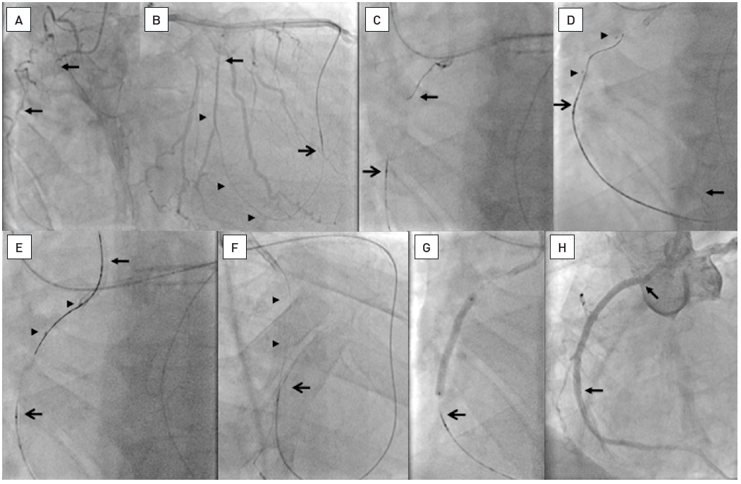

Chronic total occlusions
Figure 30
A. Occlusion of the RCA (between arrows). B. Passage of a septal collateral with a Whisper LS wire (Abbott Vascular) supported by a Corsair catheter (open arrow, ASAHI Intecc). The wire is advanced from a right ventricular side branch (arrow heads) into the segment distal to the occlusion (arrow). C. A wire (arrow; ASAHI Intecc) is advanced from the antegrade guiding catheter towards the Corsair catheter (open arrow). D. The antegrade wire is advanced distally in a side branch (arrow), and a balloon catheter (between arrow heads) advanced and inflated. Along this balloon a Miracle 3G wire (ASAHI Intecc) is advanced retrogradely. E. Finally this wire is directed into the guiding catheter (arrow). F. After advancing the Corsair catheter into the guiding catheter and exchanging the Miracle wire for a 300 cm Fielder XT (ASAHI Intecc) this wire is externalized (arrow heads) and the Corsair moved back (open arrow). G. The Corsair is further moved back (open arrow) and then ballon dilatation and stenting could be performed over the externalized wire. H. Two Everolimus-eluting stents (Xience V, Abbott Vascular) are implanted up to the ostium, which could be well controlled by retrieving the guiding catheter supported by the externalized wire.
Gerald S. Werner
©2025 Europa Group - All rights reserved.

