Slide 1


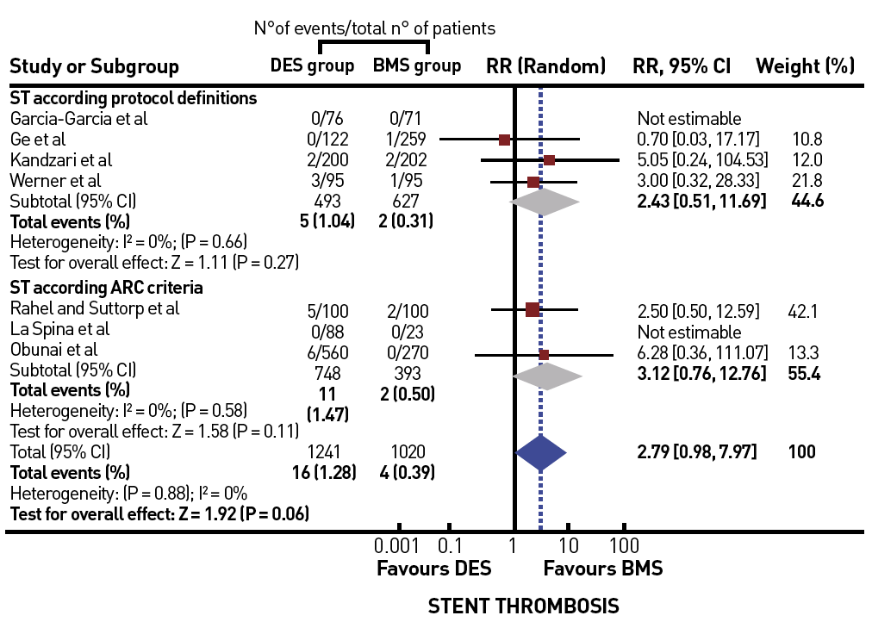

Chronic total occlusions
Figure 35B
Trend for an increased risk of stent thrombosis in CTOs treated by DES versus BMS [from [23]]
Gerald S. Werner
©2025 Europa Group - All rights reserved.

