Slide 1


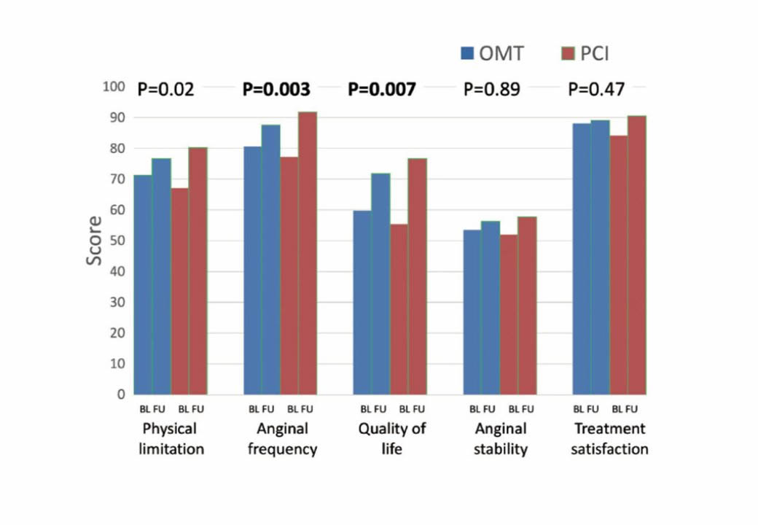

Chronic total occlusions
Figure 4
The primary outcome results from the EUROCTO trial: Seattle angina questionnaire subscale improve more 12 months after percutaneous revascularization as compared to optimal medical therapy alone in patients with stable angina pectoris and a CTO. (from [155]).
Gerald S. Werner
©2025 Europa Group - All rights reserved.

