Slide 1


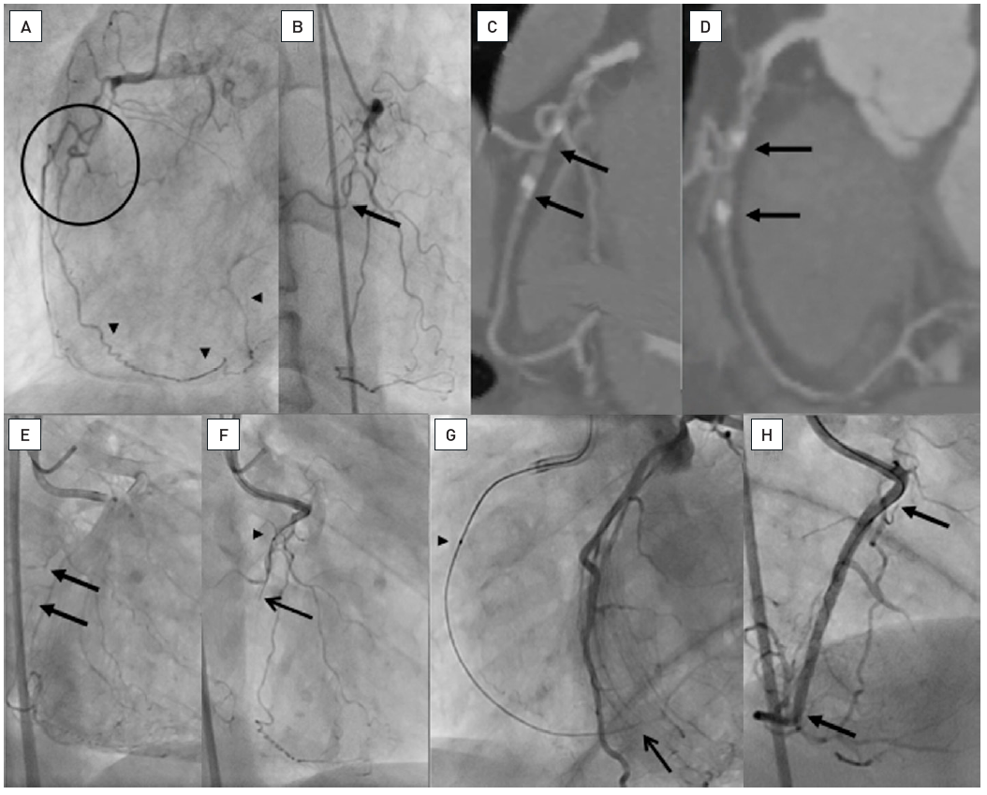

Chronic total occlusions
Figure 40
A: LAO view of a proximal RCA occlusion with several side branches obstructing the identification of the occlusion entry site (within circle). The distal PL system of the RCA is filled by an ipsilateral epicardial collateral (arrow heads). B. The RAO view with the side branches and a probable occlusion site at the take-off of a side branch (arrow). C and D. The multislice CT (MSCT) in both RAO and LAO representations reveal the occlusion site clearly identifying the occlusion between the side branch and the distal calcified spot (between arrows). E. The simultaneous injection of contrast form antegrade and contralateral identifies the site of occlusion with faint contrast filling at the end of a long filming sequence (between arrows), reassured by the MSCT. F. With the information of a short occlusion with entry without calcium, a Fielder XT (ASAHI Intecc) was chosen, supported by a Finecross microcatheter (Terumo) (arrow head). The wire successfully passes the side branch and enters the occlusion (arrow). G. Gradual advancement of the wire followed by the microcatheter (arrow head) leads to gaining the distal vascular bed, confirmed by contralateral contrast injection (arrow). H. Final result after placing two Everolimus-eluting stents (Xience V, Abbott Vascular) (between arrows).
Gerald S. Werner
©2025 Europa Group - All rights reserved.

