Slide 1


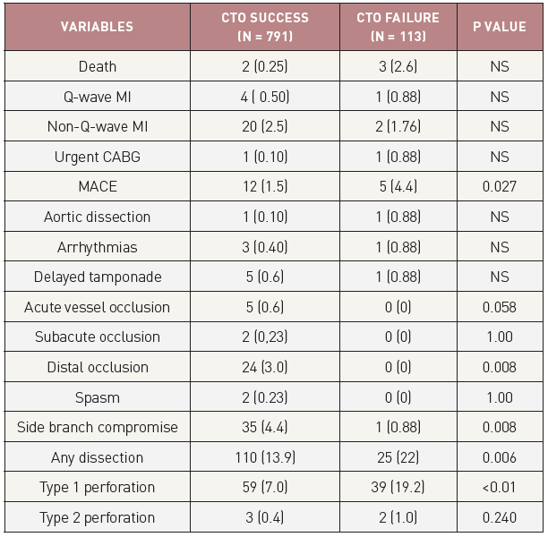

Chronic total occlusions
Figure 41
In-hospital outcomes and complications after PCI for CTO in successful and failed cases from the Toyohashi heart centre, Japan [from [77]]
Gerald S. Werner
©2025 Europa Group - All rights reserved.

