Slide 1


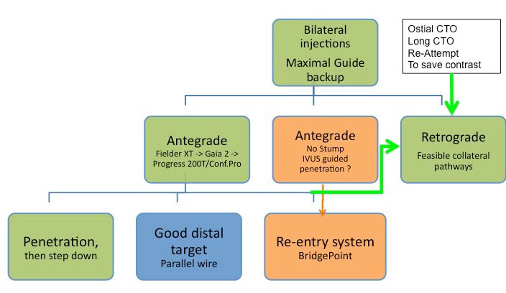

Chronic total occlusions
Figure 42
Technical options for the recanalisation procedure, according to the appearance of the proximal cap and length of the occlusion. An antegrade approach is nearly always preferred and attempted first, but according to the progress of the procedure, alternative options should be chosen like the retrograde approach or the antegrade dissection-re-entry devices. In some case, the retrograde approach might be chosen as the primary strategy.
Gerald S. Werner
©2025 Europa Group - All rights reserved.

