Slide 1


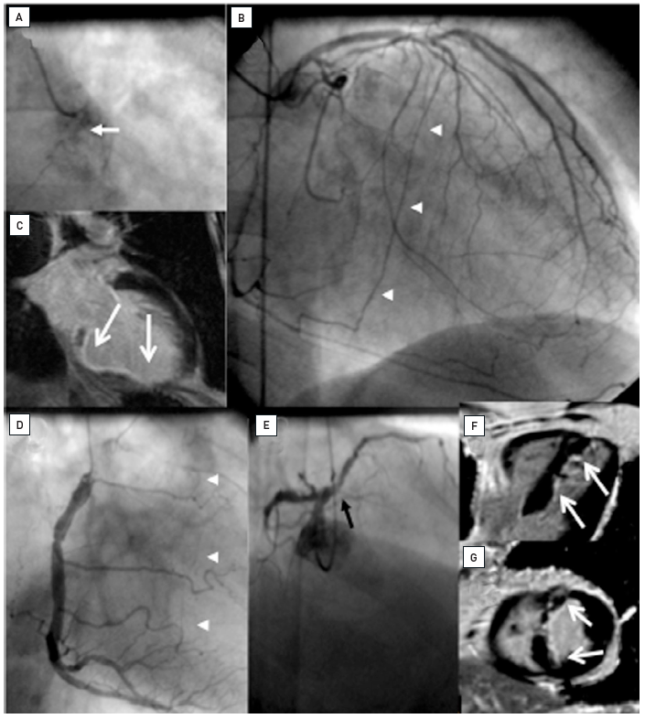

Chronic total occlusions
Figure 5
Two examples of CTOs with collateralisation, but different viability. A: Proximal RCA occlusion (arrow) supplied by well-developed CC2 collaterals (arrow heads) from the LAD (B). However, MRI shows complete transmural late enhancement (arrows, C): no indication for recanalization. E: Ostial LAD occlusion (arrow) with CC1 collaterals from the RCA (arrow heads, D). Despite this less extensive collateralisation, MRI shows only subintimal late enhancement in two views (E, F: arrows): this CTO was successfully recanalised.
Gerald S. Werner
©2025 Europa Group - All rights reserved.

