Slide 1


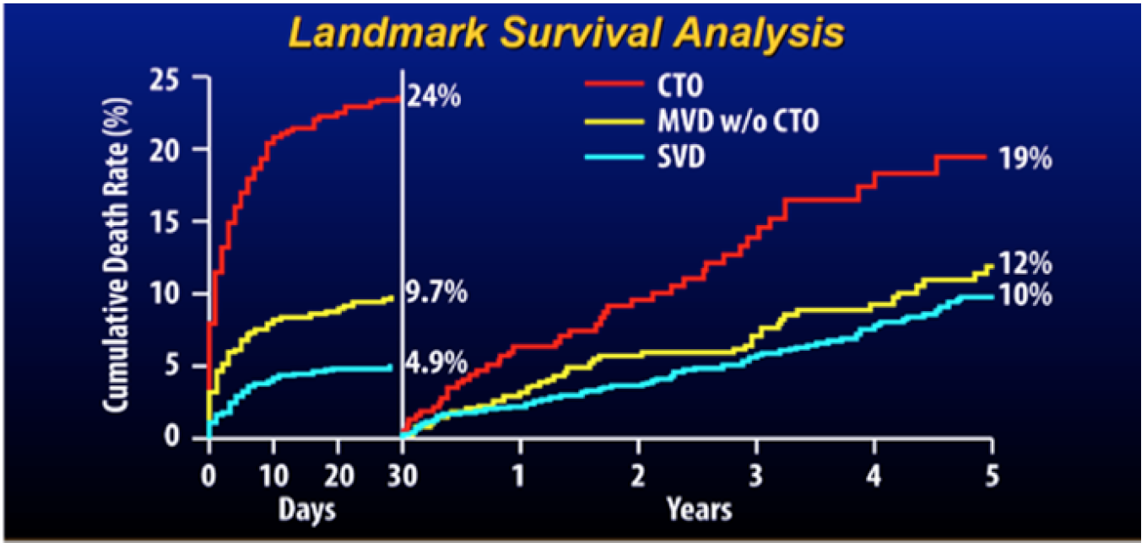

Chronic total occlusions
Figure 6
Cumulative risk of death during the first 30 days after primary percutaneous coronary intervention (PCI) and thereafter for patients with single vessel disease (SVD), multivessel disease without a chronic total occlusion (CTO) (MVD), and multivessel disease including a CTO (from [56]).
Gerald S. Werner
©2025 Europa Group - All rights reserved.

