Slide 1


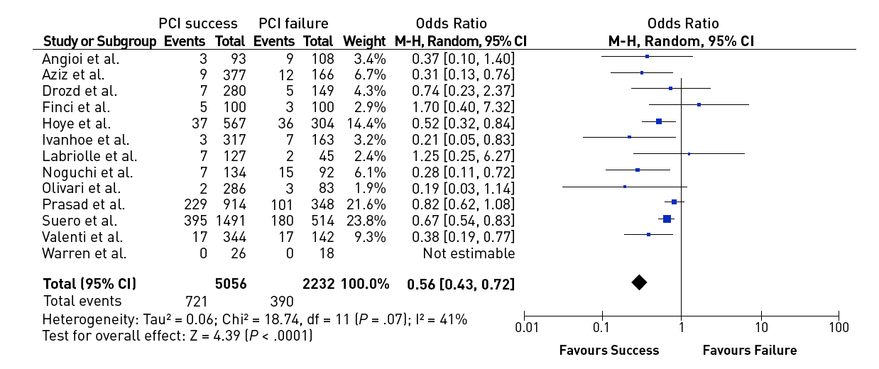

Chronic total occlusions
Figure 7
Effect of successful versus failed PCI for a CTO on all-cause mortality during follow-up [from [14]]
Gerald S. Werner
©2025 Europa Group - All rights reserved.

