Slide 1


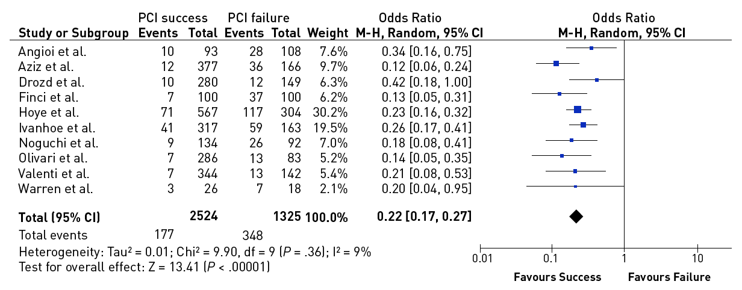

Chronic total occlusions
Figure 8
Effect of successful versus failed PCI for a CTO on the need for subsequent CABG during follow-up [from [14]].
Gerald S. Werner
©2025 Europa Group - All rights reserved.

