Slide 1


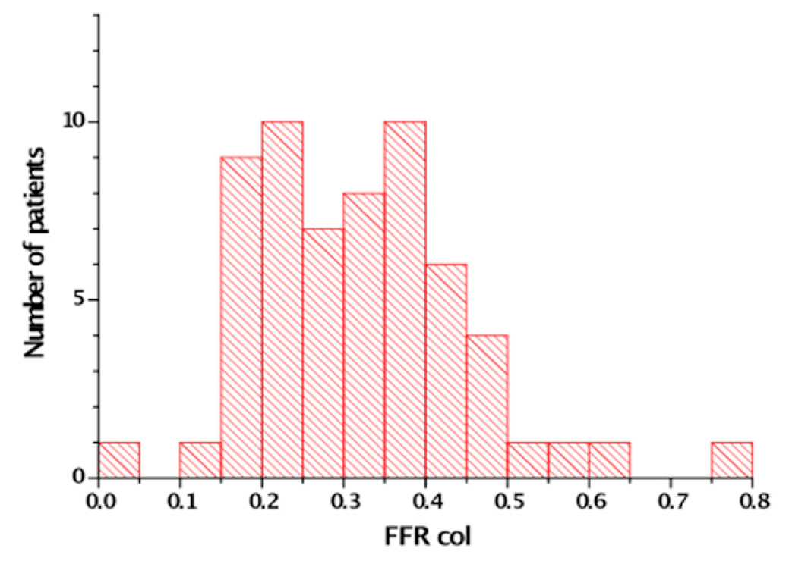

Chronic total occlusions
Figure 9
The fractional flow reserve (FFR) measured distal to a CTO after passage of a microcatheter. Maximum hyperaemia is induced by systemic infusion of adenosine (140 μg/kg/min). In 60 patients only one patient showed a FFR that was above the threshold of 0.75 [from [28]]
Gerald S. Werner
©2025 Europa Group - All rights reserved.

