Slide 1


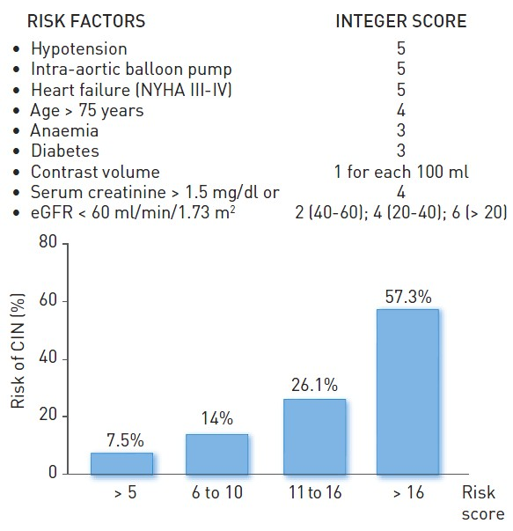

Contrast agents and renal protection (old)
Figure 2
Risk prediction scheme for the development of contrast-induced nephropathy Anaemia: baseline haematocrit value
Antonio L. Bartorelli, Giancarlo Marenzi
©2025 Europa Group - All rights reserved.

