Slide 1


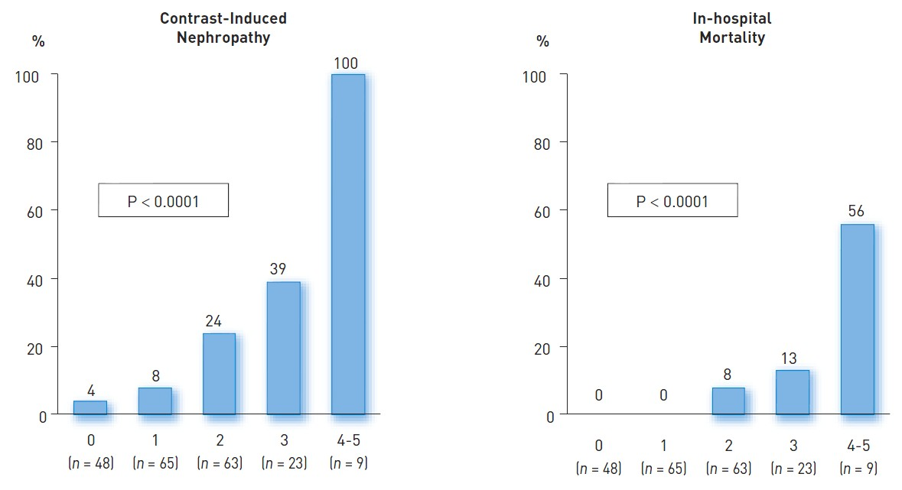

Contrast agents and renal protection (old)
Figure 3
Incidence of CIN following primary PCI Incidence of contrast-induced nephropathy (left panel) and of in-hospital death (right panel) after primary PCI, according to the risk score. A value of 1 was assigned when a factor was present and 0 when it was absent. For each patient, the score was calculated as the sum of the number of independent variables (range 0-5) recorded at hospital presentation and at the end of the coronary procedure.[modified from Marenzi et al [26]].
Antonio L. Bartorelli, Giancarlo Marenzi
©2025 Europa Group - All rights reserved.

