Slide 1


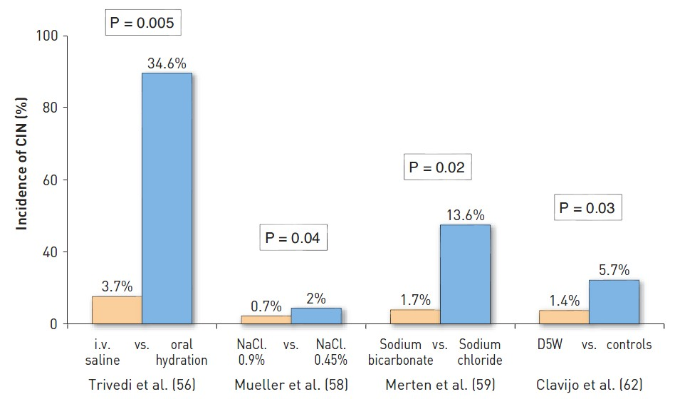

Contrast agents and renal protection (old)
Figure 4
Studies comparing different hydration protocols for the prevention of contrast-induced nephropathy. In the Trivedi et al (56), Mueller et al (58), and Clavjio et al (62) studies, CIN was defined as an increase of 0.5 mg/dL or more in serum creatinine within 48 hours. In the Merten et al (59) study, it was defined as an increase of 25% or more.CIN: contrast-induced nephropathy; i.v.: intravenous; NaCl: sodium chloride; D5: 5% dextrose.
Antonio L. Bartorelli, Giancarlo Marenzi
©2025 Europa Group - All rights reserved.

