Slide 1


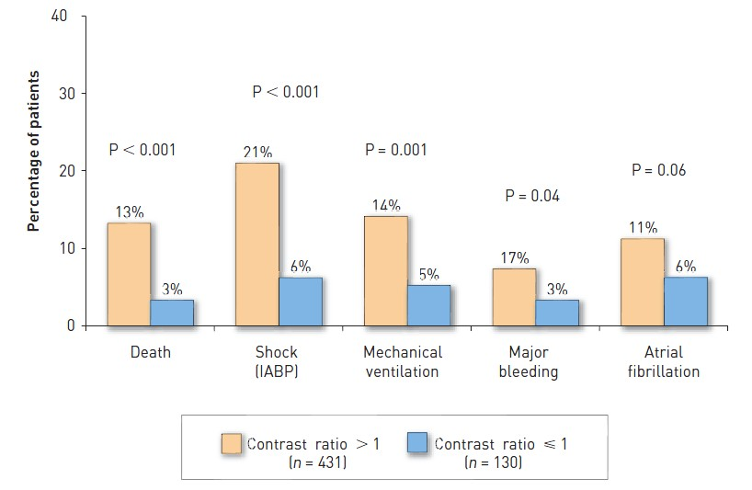

Contrast agents and renal protection (old)
Figure 5
Major in-hospital clinical complications for patients by contrast ratio below and above the maximal dose. IABP: intra-aortic balloon pump.[from Marenzi et al [152]].
Antonio L. Bartorelli, Giancarlo Marenzi
©2025 Europa Group - All rights reserved.

