Slide 1


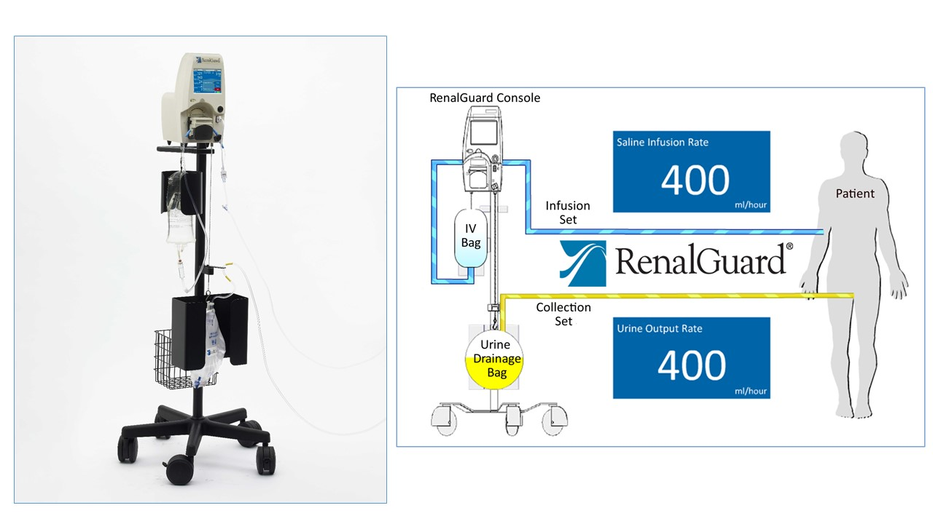

Contrast agents and renal protection (old)
Figure 6
The RenalGuard™ System is comprised of a console for real-time measurements of urinary output and a single use set for saline infusion and urine collection. The urine collection set connects to a patient's Foley catheter and the infusion set connects to a standard i.v catheter. A urinary collection bag is hung on a digital scale connected to the console that in turn drives a high volume fluid pump. The console measures the volume of urine in the collection bag and infuses an equal volume of hydration fluid to match the patient's urine output. The infusion rate is automatically matched in real time in response to changes in urine output. By administering a bolus of fluid initially (250 ml) and initiating diuresis with a small dose of furosemide (0.25-0.5 mg/kg), urine output increases to 500-600 ml/min in about 60 minutes and can be sustained for 6 hours usually without additional diuretic administration.
Antonio L. Bartorelli, Giancarlo Marenzi
©2025 Europa Group - All rights reserved.

