Slide 1


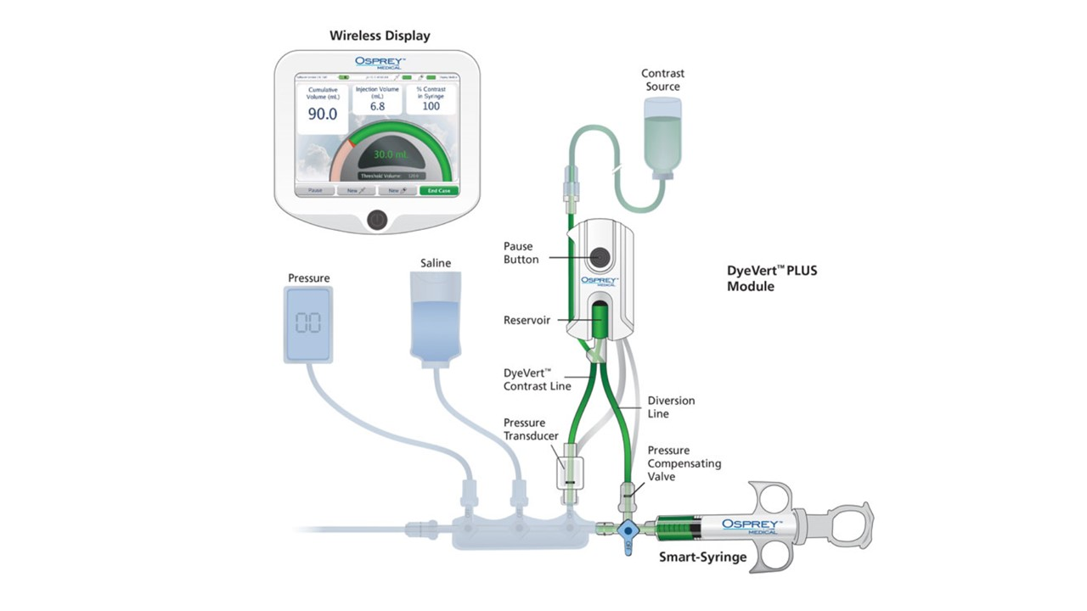

Contrast agents and renal protection (old)
Figure 7
Injections of CA into coronary arteries may result in excess reflux into the aorta that is not needed for imaging. The DyeVert™ Plus system reduces overall CA amount diverting dye on each injection, including puffs without compromising image quality. Reservoir temporarily stores diverted CA to be used on next injection. A pressure compensating valve system automatically self-adjusts for different catheter configurations and injection rates.
Antonio L. Bartorelli, Giancarlo Marenzi
©2025 Europa Group - All rights reserved.

