Slide 1


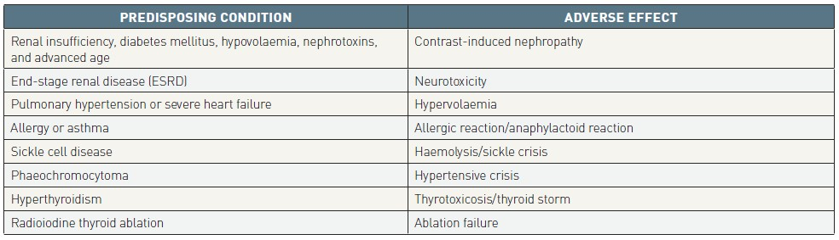
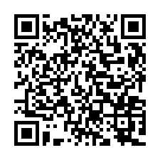
Contrast agents and renal protection (old)
Table 2
Adverse effects of contrast agents in specific conditions
Antonio L. Bartorelli, Giancarlo Marenzi
©2025 Europa Group - All rights reserved.

