Slide 1


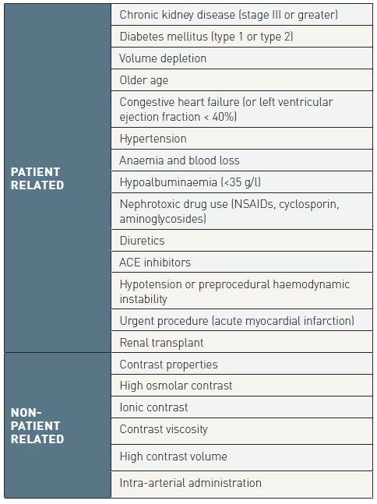

Contrast agents and renal protection (old)
Table 3
Risk factors for contrast-induced nephropathy (ACE: angiotensin-converting enzyme; NSAIDs: non-steroidal anti-inflammatory drugs)
Antonio L. Bartorelli, Giancarlo Marenzi
©2025 Europa Group - All rights reserved.

