Slide 1


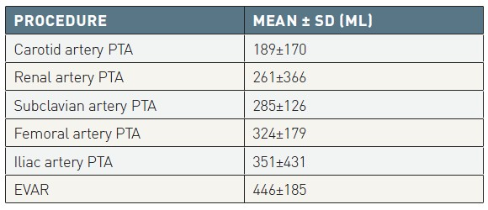

Contrast agents and renal protection (old)
Table 4
Average contrast agent volume in peripheral vascular interventions at the Centro Cardiologico Monzino.*[from Marenzi and Bartorelli [39]]*32% of the index procedures were associated with other peripheral or coronary interventions. EVAR: endovascular aortic repair; PTA: percutaneous transluminal angioplasty PROCEDUREMEAN
Antonio L. Bartorelli, Giancarlo Marenzi
©2025 Europa Group - All rights reserved.

