Slide 1


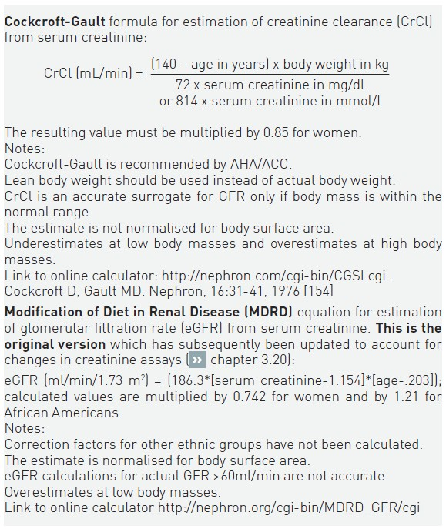

Contrast agents and renal protection (old)
Table 5
Formulae for the estimation of creatinine clearance and glomerular filtration rate
Antonio L. Bartorelli, Giancarlo Marenzi
©2025 Europa Group - All rights reserved.

