Slide 1


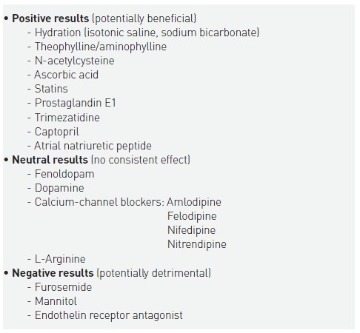

Contrast agents and renal protection (old)
Table 6
Pharmacologic strategies evaluated for contrast-induced nephropathy risk reduction
Antonio L. Bartorelli, Giancarlo Marenzi
©2025 Europa Group - All rights reserved.

