Slide 1


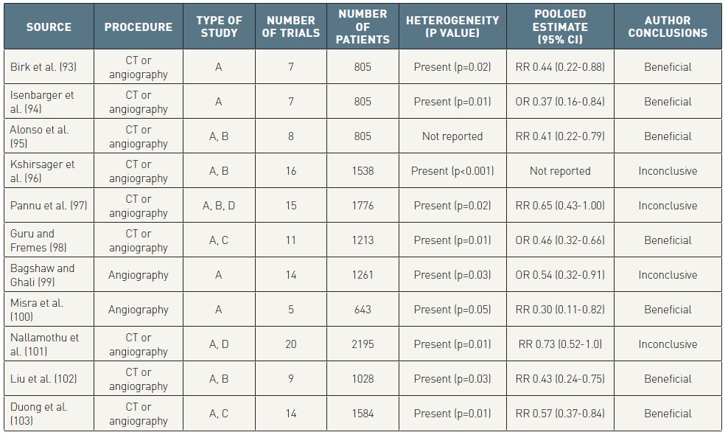

Contrast agents and renal protection (old)
Table 7
Meta-analyses of studies on the prophylactic use of N-acetylcysteine to prevent contrast-induced nephropathy. A= randomized controlled trials (articles), B= randomized controlled trials (abstracts), C= not randomized trials (articles), D= unpublished; CT = computed tomography; RR = relative risk; OR = odd ratio; CI = confidence intervals.[modified from Bagshaw SM et al. Arch Intern Med 2006;166:161-166]
Antonio L. Bartorelli, Giancarlo Marenzi
©2025 Europa Group - All rights reserved.

