Slide 1


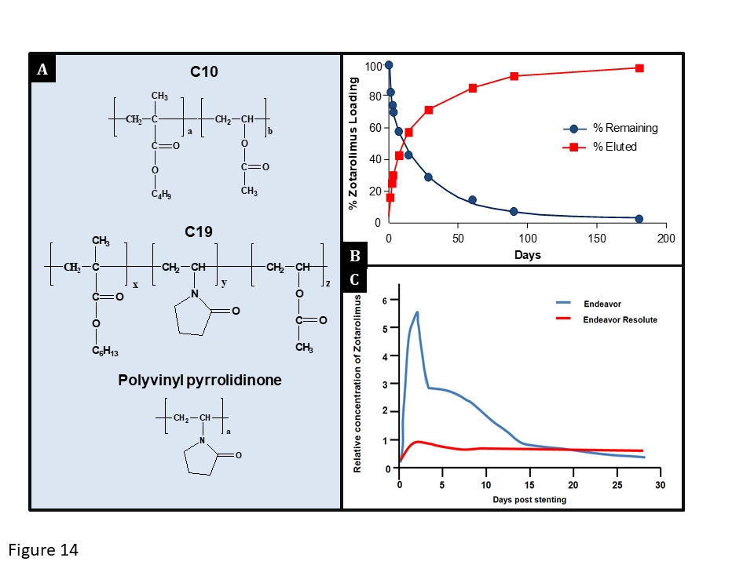

Coronary artery stents (old)
Figure 14
The Endeavor® Resolute stent. (A) The chemical structure of the three components of the BioLinx™ polymer system. The hydrophobic C10 polymer is based on hydrophobic butyl methacrylate to provide adequate hydrophobicity for zotarolimus. The hydrophilic C19 polymer is manufactured from a mixture of hydrophobic hexyl methacrylate, and hydrophilic vinyl pyrrolidinone and vinyl acetate monomers, to provide enhanced biocompatibility. The hydrophilic polyvinyl pyrrolidinone increases the initial drug burst and enhances biocompatibility. (B) The drug release pattern of zotarolimus: >85% is released within the first 60 days, with drug elution complete by 180 days. (C) A comparison of the relative arterial concentrations of zotarolimus in the porcine coronary artery model at various times post implantation of the Endeavor® and Endeavor® Resolute stents. The Endeavor® stent maintains effective drug levels through the initial loading of arterial tissue with zotarolimus during the first two weeks of elution. Conversely, the Endeavor® Resolute stent sustains an effective drug level in the tissue through continued, sustained elution. (B) and (C) are reproduced with permission from [183] and Udipi et al EuroIntervention. 2007;3:137-9 respectively.
Scot Garg, Sharmaine Thirunavukarasu, Raffaele Piccolo, Patrick W. Serruys, Stephan Windecker
©2025 Europa Group - All rights reserved.

