Slide 1


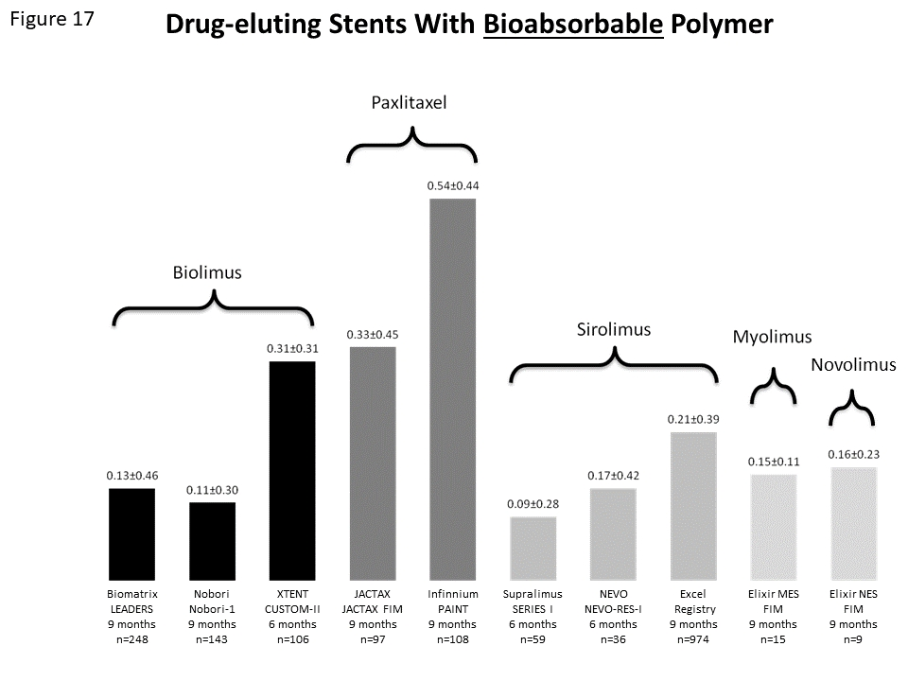

Coronary artery stents (old)
Figure 17
Late lumen loss of different stent platforms using bioresorbable polymers as drug carrier.
Scot Garg, Sharmaine Thirunavukarasu, Raffaele Piccolo, Patrick W. Serruys, Stephan Windecker
©2025 Europa Group - All rights reserved.

