Slide 1


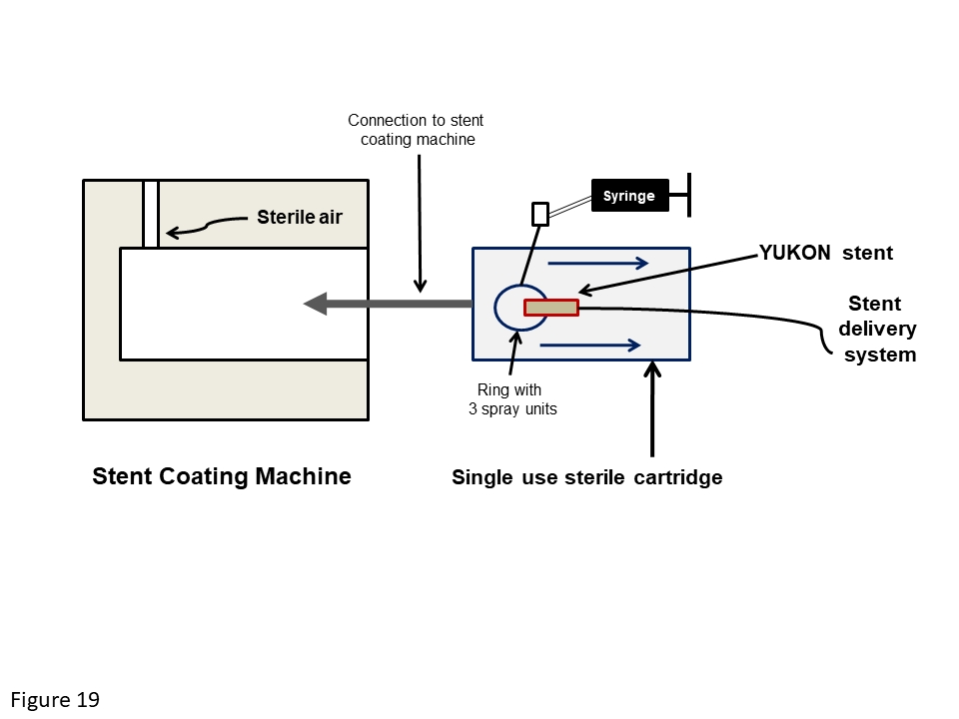

Coronary artery stents (old)
Figure 19
Schematic diagram of the YUKON stent coating machine. The stent is inserted into a sterile single-use cartridge which is placed in the stent coating machine. The syringe is used to inject the antiproliferative drug, which is sprayed uniformly over the stent using 3 spray units. Following the spray coating, the stent is dried using sterile pressurized air.
Scot Garg, Sharmaine Thirunavukarasu, Raffaele Piccolo, Patrick W. Serruys, Stephan Windecker
©2025 Europa Group - All rights reserved.

