Slide 1


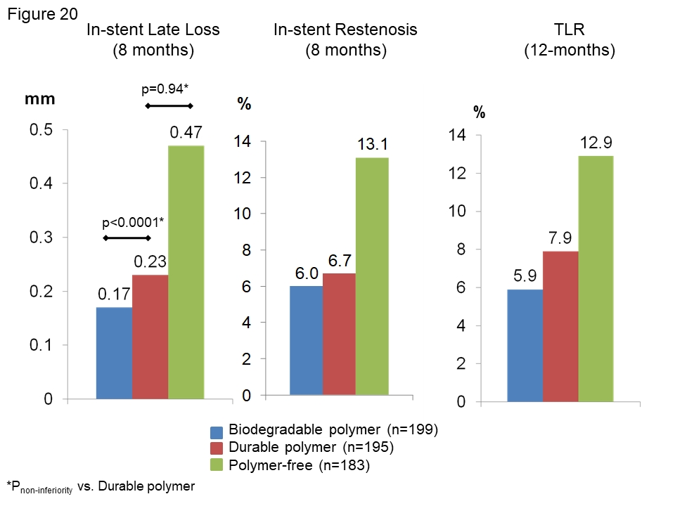

Coronary artery stents (old)
Figure 20
Results of the ISAR-TEST 3 study. Patients were treated with three different sirolimus-eluting stent platforms: the durable polymer (red), biodegradable polymer (blue) or polymer-free (green).
Scot Garg, Sharmaine Thirunavukarasu, Raffaele Piccolo, Patrick W. Serruys, Stephan Windecker
©2025 Europa Group - All rights reserved.

