Slide 1


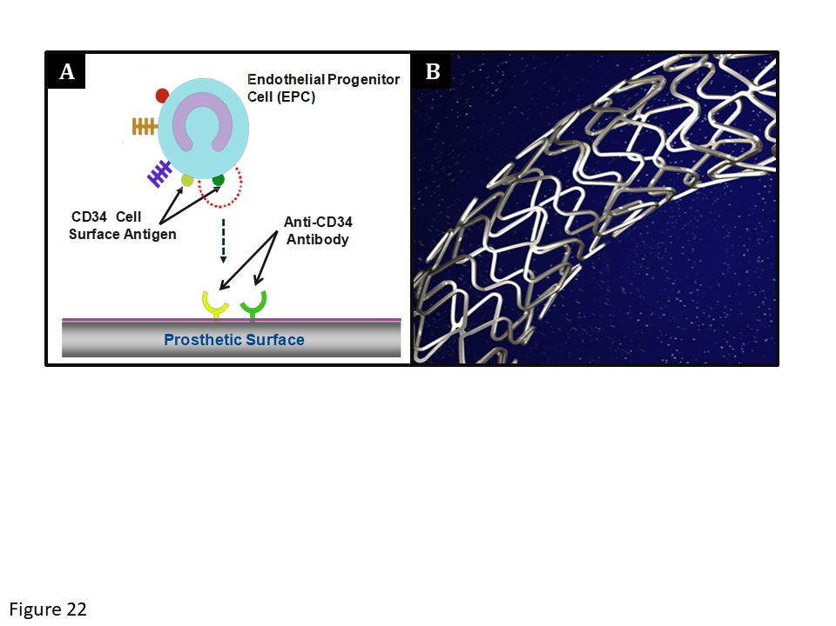

Coronary artery stents (old)
Figure 22
The Genous stent. (A) Schematic representation of the endothelial progenitor cell (EPC) capture technology. The CD-34 antigens on the surface of the EPCs attach to the anti-CD-34 antibodies on the stent’s surface with the aim of promoting endothelialisation. (B) The stainless steel Genous™ stent; (courtesy of OrbusNeich).
Scot Garg, Sharmaine Thirunavukarasu, Raffaele Piccolo, Patrick W. Serruys, Stephan Windecker
©2025 Europa Group - All rights reserved.

