Slide 1


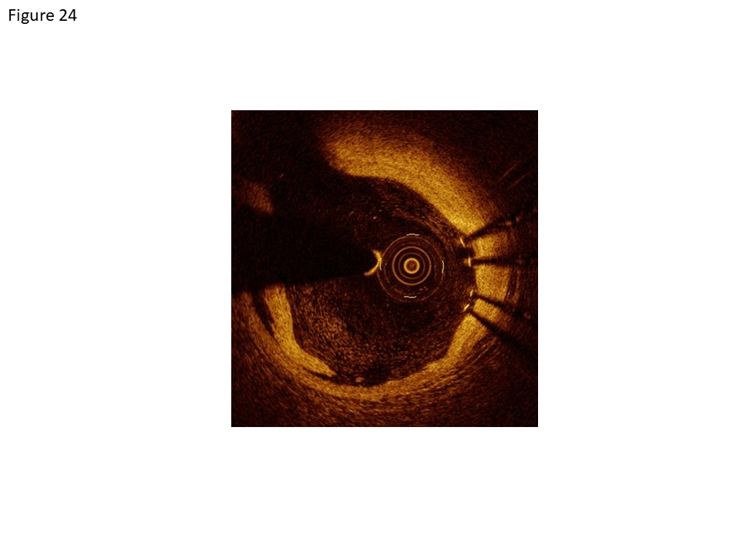

Coronary artery stents (old)
Figure 24
OCT image of an intimal dissection at the proximal stent border with the dissection flap at 7 o’clock and stent struts at 3 o’clock [C7, Lightlab, St.Jude Medical Company].
Scot Garg, Sharmaine Thirunavukarasu, Raffaele Piccolo, Patrick W. Serruys, Stephan Windecker
©2025 Europa Group - All rights reserved.

