Slide 1


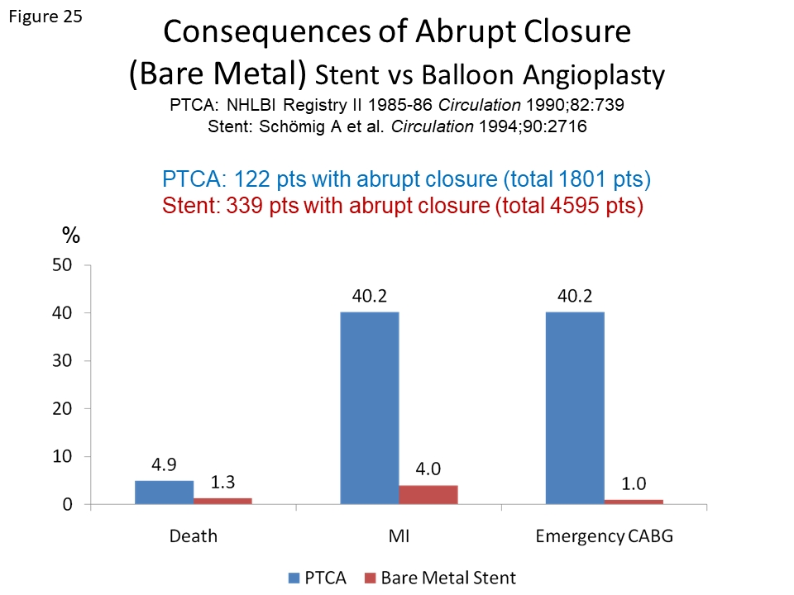

Coronary artery stents (old)
Figure 25
Clinical consequences of abrupt closure following BMS implantation (in red) as compared with ballon angioplasty treatment (in blue).
Scot Garg, Sharmaine Thirunavukarasu, Raffaele Piccolo, Patrick W. Serruys, Stephan Windecker
©2025 Europa Group - All rights reserved.

