Slide 1


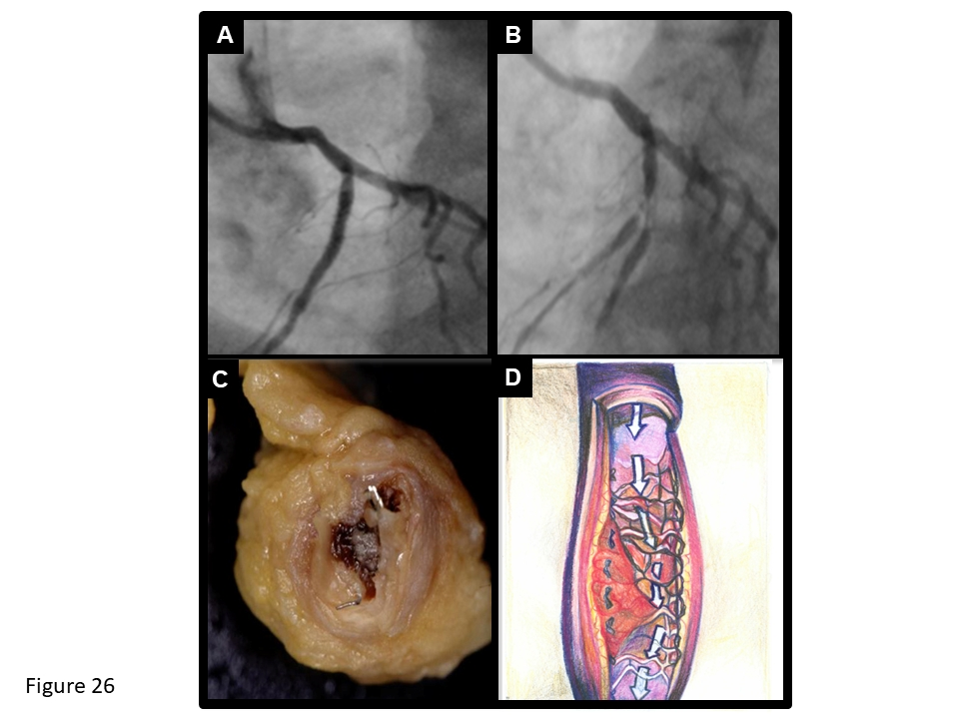

Coronary artery stents (old)
Figure 26
Angiographic, autopsy and schematic drawing of ST. Drug-eluting stent implantation of the proximal left anterior descending artery (A) complicated by ST (B) occuring 7 months later, shortly after discontinuation of DAPT. Gross pathological example of ST (C) and schematic drawing of underlying mechanisms including uncovered and malapposed struts (D).
Scot Garg, Sharmaine Thirunavukarasu, Raffaele Piccolo, Patrick W. Serruys, Stephan Windecker
©2025 Europa Group - All rights reserved.

