Slide 1


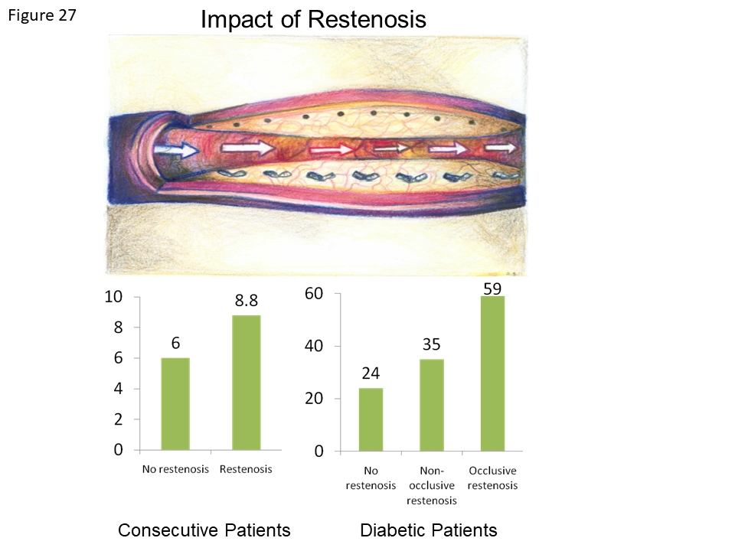

Coronary artery stents (old)
Figure 27
Clincal impact of restenosis during long-term follow-up in observational studies. On the left side, the 4-year mortality is shown in patients with versus without restenosis following BMS implantation showing an increase in overall mortality in patients with restenosis. On the right side, the 10-year mortality of diabetic patients with no versus non-occlusive versus occlusive restenosis is shown. Mortality is lowest among diabetic patients without restenosis and highest among diabetic patients with occlusive restenosis.
Scot Garg, Sharmaine Thirunavukarasu, Raffaele Piccolo, Patrick W. Serruys, Stephan Windecker
©2025 Europa Group - All rights reserved.

