Slide 1


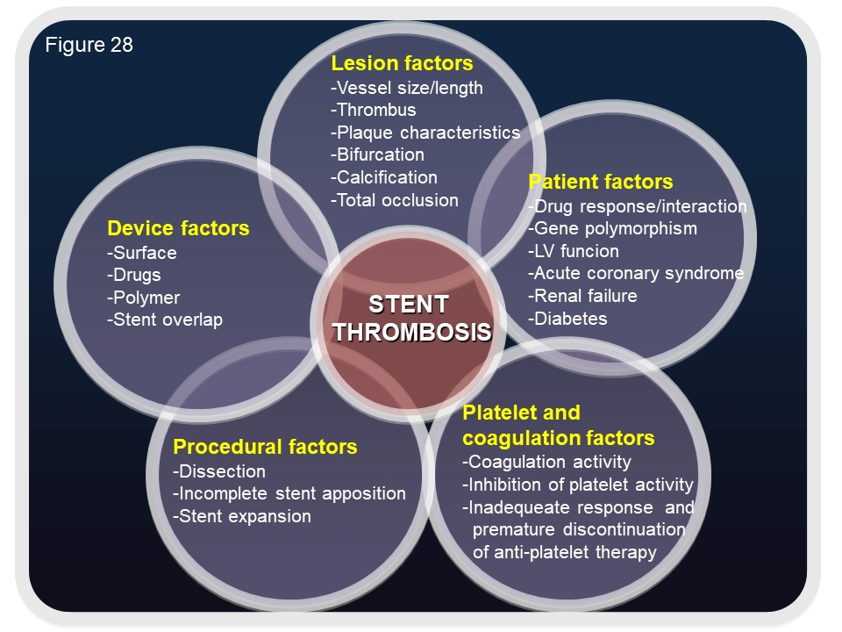

Coronary artery stents (old)
Figure 28
Multiple factors have been identified to portend an increased risk of ST following drug-eluting stent implantation including patient-related factors, procedural characteristics, lesion properties, device factors and antiplatelet and coagulation factors.
Scot Garg, Sharmaine Thirunavukarasu, Raffaele Piccolo, Patrick W. Serruys, Stephan Windecker
©2025 Europa Group - All rights reserved.

