Slide 1


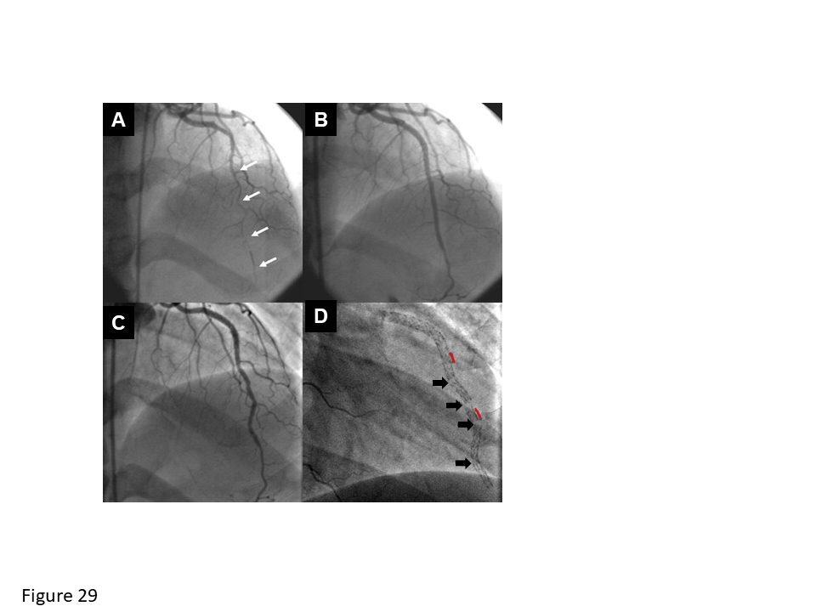

Coronary artery stents (old)
Figure 29
Stent fracture. (A) long, diffusely diseased left anterior descending artery was treated with 3 SES (white arrows). (B) The initial angiographic result is excellent, however, at (C) 3-months’ follow-up, an irregular appearance is seen, and is the result of (D) 4 stent fractures (black arrows) occuring adjacent to regions of stent overlap (red lines).
Scot Garg, Sharmaine Thirunavukarasu, Raffaele Piccolo, Patrick W. Serruys, Stephan Windecker
©2025 Europa Group - All rights reserved.

