Slide 1


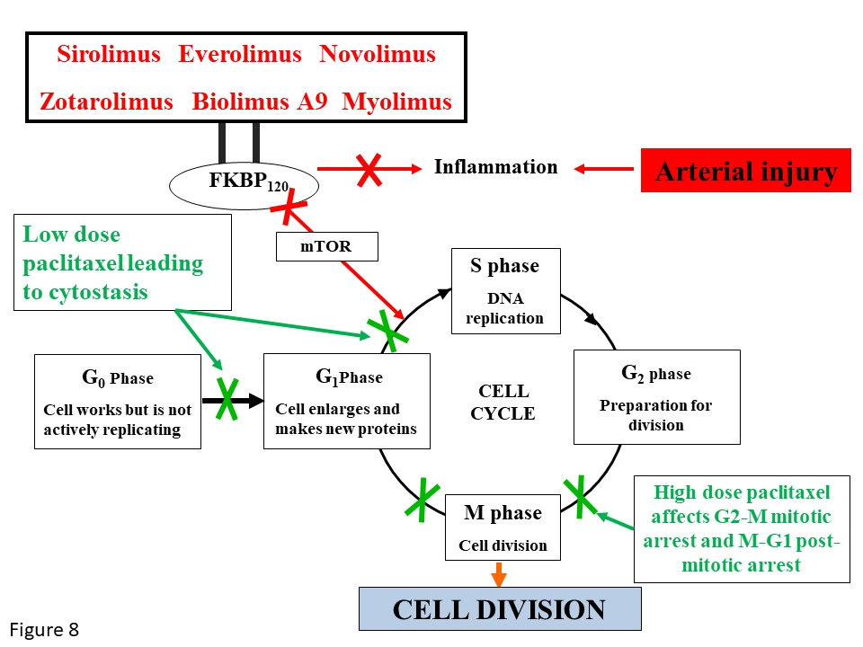

Coronary artery stents (old)
Figure 8
Mechanism of action of antiproliferative drugs of the limus family and of paclitaxel.
Scot Garg, Sharmaine Thirunavukarasu, Raffaele Piccolo, Patrick W. Serruys, Stephan Windecker
©2025 Europa Group - All rights reserved.

