Slide 1


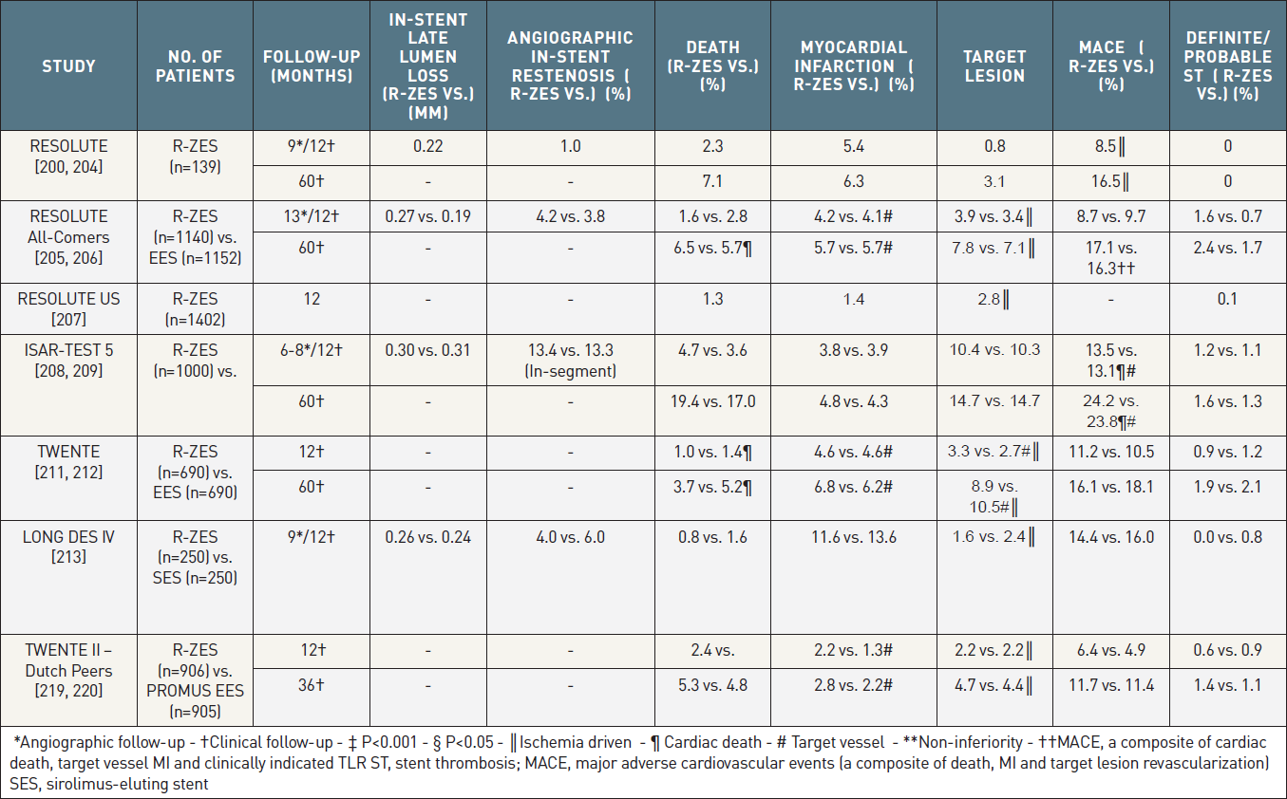

Coronary artery stents (old)
Table 10
The most prominent randomized trials and registries of the 2nd generation RESOLUTE zotarolimus-eluting stent. Differences non-significant unless indicated.
Scot Garg, Sharmaine Thirunavukarasu, Raffaele Piccolo, Patrick W. Serruys, Stephan Windecker
©2025 Europa Group - All rights reserved.

