Slide 1


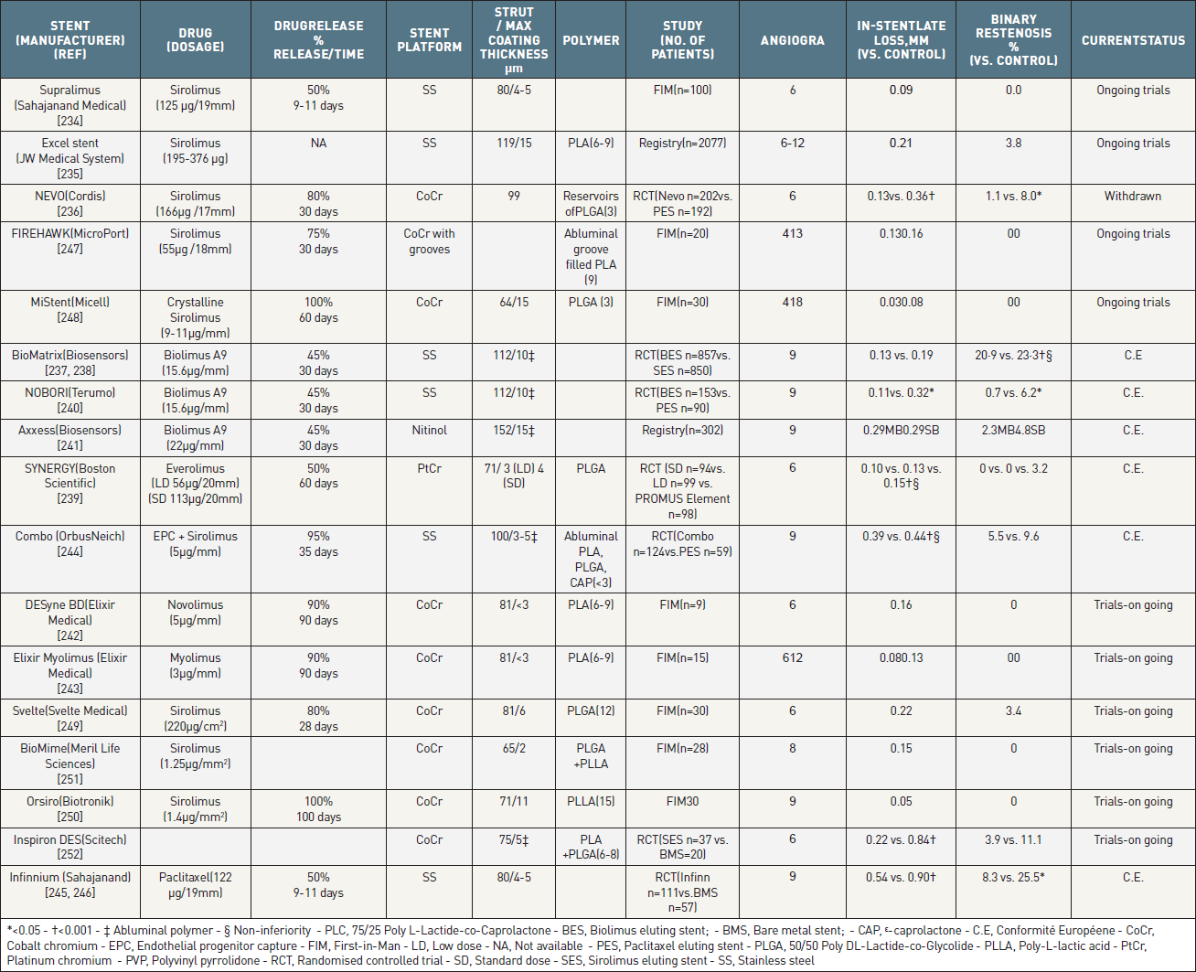

Coronary artery stents (old)
Table 12
Metallic stents with a biodegradable polymer which are either currently available outside the USA, or undergoing clinical evaluation.All differences are not significant unless stated.
Scot Garg, Sharmaine Thirunavukarasu, Raffaele Piccolo, Patrick W. Serruys, Stephan Windecker
©2025 Europa Group - All rights reserved.

