Slide 1


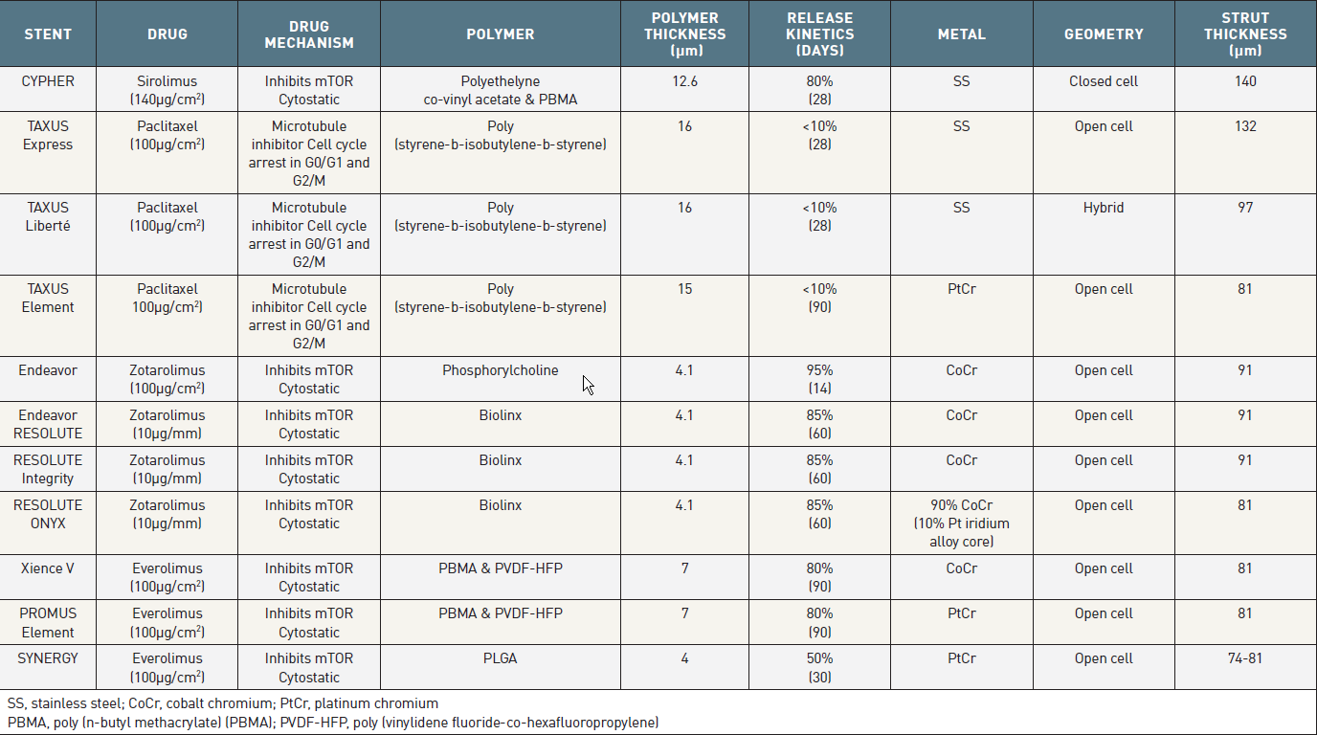

Coronary artery stents (old)
Table 2
Specificications of the FDA Approved DES
Scot Garg, Sharmaine Thirunavukarasu, Raffaele Piccolo, Patrick W. Serruys, Stephan Windecker
©2025 Europa Group - All rights reserved.

