Slide 1


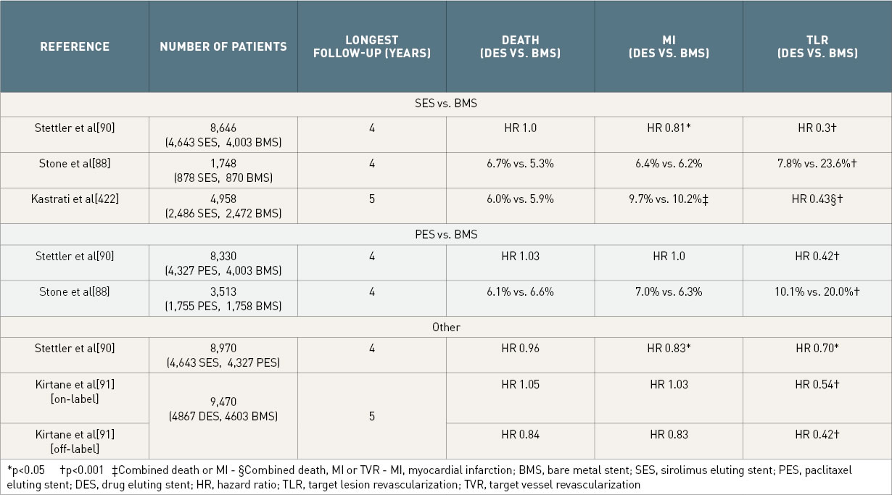

Coronary artery stents (old)
Table 4
Rates of death, myocardial infarction and target lesion revascularization from recent meta-analyses of drug eluting stents compared to bare metal stents. Differences non-significant unless indicated. *p
Scot Garg, Sharmaine Thirunavukarasu, Raffaele Piccolo, Patrick W. Serruys, Stephan Windecker
©2025 Europa Group - All rights reserved.

