Slide 1


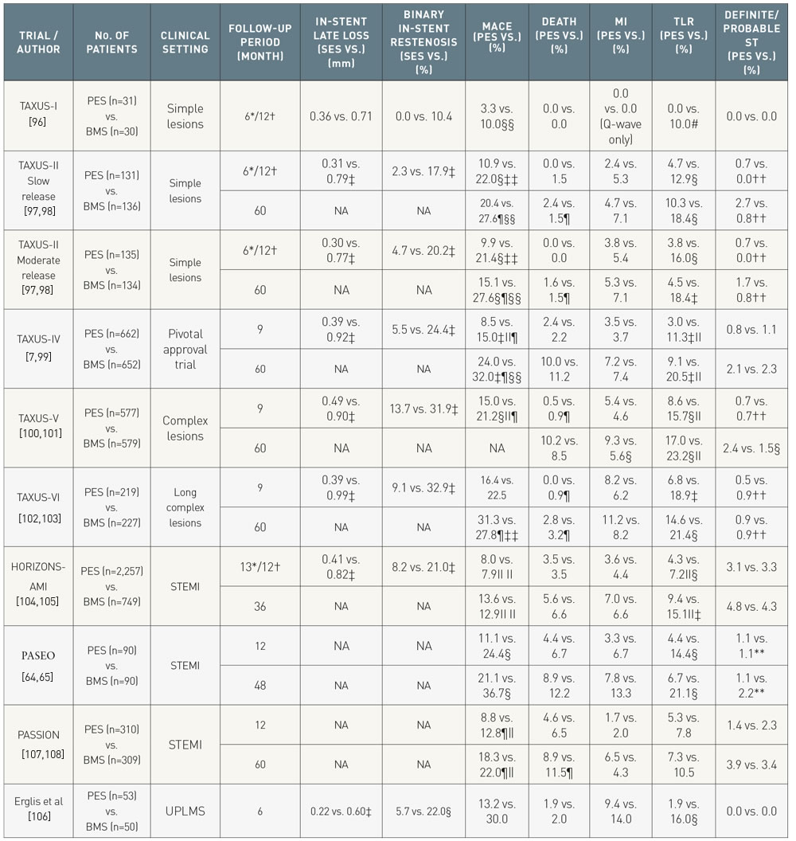

Coronary artery stents (old)
Table 5
Summary of major randomized trials of paclitaxel eluting stent versus bare metal stents in different clinical settings. Differences are non-significant unless stated. Stent thrombosis as per ARC definition, unless indicated. *Angiographic follow-up †Clinical follow-up ‡ P
Scot Garg, Sharmaine Thirunavukarasu, Raffaele Piccolo, Patrick W. Serruys, Stephan Windecker
©2025 Europa Group - All rights reserved.

